Slide 1
FRPA 101-J MASS WASTING

Slide 2
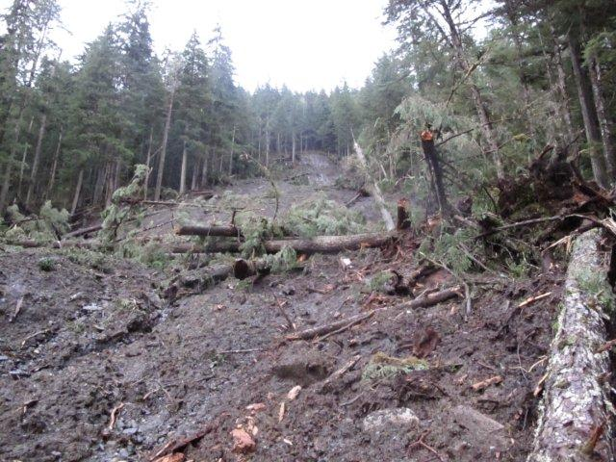
Definitions
mass wasting: the slow to rapid downslope movement of significant masses of earth material of varying water content, primarily under the force of gravity
11 AAC 95.900(44)
5-mile Pit slide – Mitkof Island

Slide 3
Detailed Plans of Operation (DPOs)

Slide 4
DPO
Before beginning an operation on forest land, the operator shall file a DPO with DOF at the area office with jurisdiction over the geographic area in which the operations will occur.
A DPO must be submitted on a form provided by DOF
11 AAC 95.220(a)(9)

Slide 6
Required information
(9) for areas in cutting units or traversed by roads:
(A) any known unstable area
(B) slope gradient >67%
11 AAC 95.220(a)(9)

Slide 7
Identifying known unstable areas or unstable slopes
Consider sites with slopes generally >50% gradient, where one or more of the following indicators exist:
(i) landslide scars;
(ii) jack-strawed trees;
(iii) gullied or dissected slopes;
(iv) a high density of streams or zero-order basins
(v) evidence of soil creep;
11 AAC 95.220(a)(9)
Notes:
From purple book:
The procedures in Chatwin, et al., 1994 are recommended for additional guidance on assessing landslide risk. The citation for Chatwin et al., 1994 is: Chatwin, S. C., D. E. Howes, J. W. Schwab, and D. N. Swanston. 1994. A guide for management of landslide-prone terrain in the Pacific Northwest. 2nd ed. British Columbia Ministry of Forests and U.S. Forest Service. 218 pp. This publication is available on-line through the British Columbia Ministry of Forests, Lands and Natural Resource Operations at:
http://www.for.gov.bc.ca/hfd/pubs/docs/lmh/Lmh18.htm

Slide 8
Definition: “zero-order basin”
“zero-order basin” means a source basin for a headwater stream
11 AAC 95.220(a)(9)

Slide 9
Landslide hazard scoping maps
Source: Prepared by the Landslide Science & Technical Committee, 2011
For copies of the maps, information on the model used to develop them, and caveats on their use, se: http://forestry.alaska.gov/forestpractices#landslides
Notes:
The hazard model and scoping maps were developed to help the Landslide Science and Technical Committee and Board of Forestry assess the geographic extent of potential landslide risks to public safety. The maps online also show past harvest areas and municipal boundaries.
Caveats on use of the maps are in the addendum at the end of this module.

Slide 10
Change in operations
Notify DOF of a change in operations from those described in the DPO that is likely to cause significant adverse impact to fish habitat or surface water quality.
Changes in operations that require agency review include:
a new or reconstructed bridge, road segment, or material disposal site that crosses surface waters, abuts a riparian area, or is on unstable soils
11 AAC 95.230 (a)(1)

Slide 11
FRPA Standards

Slide 12
General standards
On all forest lands:
Prevent or minimize significant adverse effects of soil erosion and mass wasting on water quality and fish habitat
Conduct operations in a manner that does not cause or constitute a substantial factor in causing a degradation of water quality
On state and municipal forest land:
Do not significantly impair the productivity of the land and water with respect to renewable resources
AS 41.17.060(b)(5),(c)(5); 11 AAC 95.185(a),(b)

Slide 13
Road construction
Where feasible, avoid locating a road on a slope >67% or on an unstable slope.
If avoiding that slope is not feasible, site-specific measures must be planned to address slope instability due to road construction. The measures must be approved by DOF and must meet the requirements for road construction in 11 AAC 95.290(b).
11 AAC 95.290(a)
Notes:
Note: terms defined by statute or regulation are shown in color

Slide 14
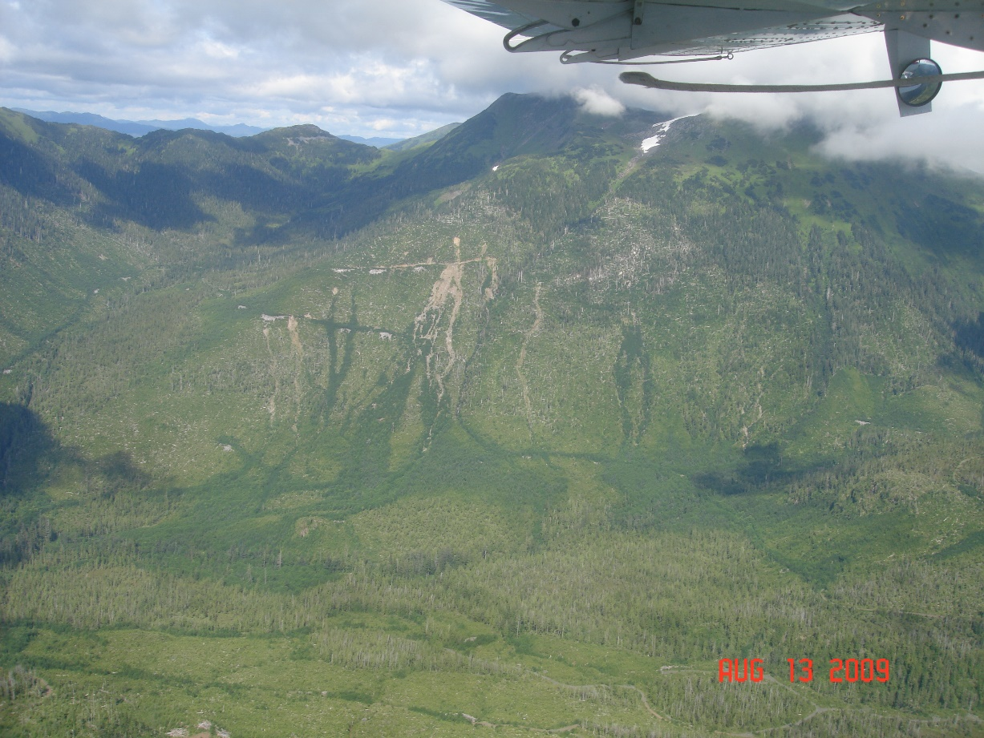
Definitions
unstable slope: a slope exhibiting mass wasting or where mass wasting is likely to occur.
11 AAC 95.900(95)
Landslide scars of varying ages – Prince of Wales Island near Hollis. Photo: Jeff Foley

Slide 15
Road construction on unstable slopes
If constructing a road on a slope >67 % or on an unstable slope is necessary,
Do not bury, except as puncheon across swampy ground or for culvert protection,
a log chunk >5 cubic feet in volume or a loose stump, in the load-bearing portion of a road;
any significant amount of organic debris within the load-bearing portion of a road;
excessive accumulation of debris or slash in the road-bearing portion of a road fill;
11 AAC 95.290(b)(1)

Slide 16
Road construction on unstable slopes, cont.
If constructing a road on a slope >67 % or on an unstable slope is necessary,
Balance cuts and fills so that as much of the excavated material as is feasible is deposited in the roadway fill section; however, unstable fill material may not be used, and cuts must be minimized where fine textured soils are known or encountered.
11 AAC 95.290(b)(2)

Slide 17
Definitions
fine textured soil: mineral soil with a texture of silty-clay, sandy-clay, or clay
unstable fill material: organic debris, organic soil, or fine textured soil
11 AAC 95.900(93),(94)

Slide 18
Road construction on unstable slopes, cont.
If constructing a road on a slope >67 % or on an unstable slope is necessary,
do not conduct excavation and blasting activities during saturated soil conditions if mass wasting is likely to result ­and cause degradation of surface or standing water quality.
11 AAC 95.290(b)(3)

Slide 19
Saturated soil
saturated soil: soil that has all of its voids completely filled with water, to the point where the addition of any further water will result in a rising surface water table.
11 AAC 95.900(72)

Slide 20
Evidence of saturated soil
Evidence of saturated soil conditions on a steep slope or unstable area may include:
On cutslopes, noticeable soil liquefaction or movement of large soil particles to the ditchline
Significant water flow evident on the surface, exposed bedrock, or impermeable hardpan
Excavated or disturbed material performing in a liquid manner
High rainfall rates in previous 24 hours, e.g., 6 inches in a 24-hour period, or prolonged periods of heavy rainfall
Heavy rain following extended periods of freezing
Heavy rain-on-snow events”
Purple book

Slide 21
Road construction: sedimentation
To prevent or minimize sedimentation, treat unstable soils with effective and appropriate erosion control measures such as grass seeding, erosion control mats, or end-hauling of materials.
11 AAC 95.290(c)

Slide 22
Minimizing sedimentation
Sedimentation is less likely the farther away the road is from the stream. Intervening vegetation or terrain features can filter and trap sediment.
Low spots or intervening ridges can intercept runoff, allowing suspended sediment to filter or settle out before reaching surface waters.
Unstable soils usually must be stabilized before any measures can be taken to prevent or minimize erosion and revegetate exposed soils.
Purple book re 11 AAC 95.290(c)

Slide 23
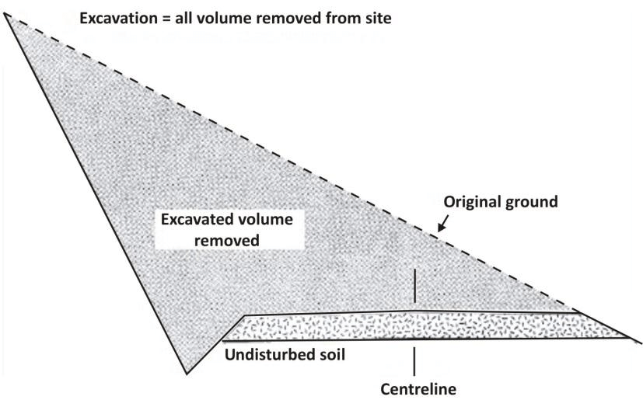
Road construction: end haul/full-bench
Use end-hauling and full-bench construc­tion techniques if mass wasting from overloading on an unstable slope or erosion of side-cast material is likely to occur and cause degrada­tion of surface or standing water quality. 11 AAC 95.290(d)
Full-bench construction. From Van der Hout (2014)
Notes:
Diagram from: Van der Hout, P. (2014). Code of Practice for Forest Operations (3rd edition) for Timber Sales Agreement and Wood cutting License Holders.

Slide 24
End hauling & full bench
Do not place fill for road construction or side-cast excavated material on unstable slopes; this can cause landslides or debris torrents.
Do not side-cast fine-grained, erodible material near surface waters. Take it to a spoil disposal site where the terrain and vegetation allow suspended sediment to filter or settle out before runoff from the site can reach any surface waters.
Purple book re 11 AAC 95.290(d)

Slide 25
Material extraction & disposal sites
If feasible, verify that suitable material is present at a proposed extraction site before stripping the entire site of surface soils.
A material extraction site must be located in an area where the risk of causing significant harm to fish habitat through soil erosion and mass wasting is minimal.
Locate an area to deposit material extraction site overburden and end hauling material where the risk of causing significant harm to fish habitat through soil erosion and mass wasting is minimal.
11 AAC 95.325 (a)(4), (b)(3)

Slide 26
Rehabilitation after mass wasting
Where mass wasting is caused by operations, the operator shall, to the extent feasible, take effective and appropriate measures to stabilize the slide path and all associated exposed soils, such as:
grass seeding,
erosion control mats,
excavation of the head wall to the angle of repose,
placement of ballast to control mass wasting, or
other effective slope stabilization methods.
11 AAC 95.330 (a)

Slide 27
Rehabilitation after mass wasting
DOF may require an operator to remove debris from surface waters impacted by mass wasting, to the degree necessary to restore water quality or fish habitat.
Ditchline water must be directed away from mass wasting and into vegetated areas.
11 AAC 95.330 (b),(c)

Slide 28
Landings
Background: Landings can disturb a lot of ground, drainage from haul and yarding roads lead towards them, and they can intercept ephemeral drainages. Landings are generally level and at least partially built on fill. Constant equipment operation and standing water can cause excessive deformation of the surface material and generate sediment. Poor drainage combined with the weight of fill material on steep side hills can lead to fill failures and mass wasting.
Purple book re 11 AAC 95.345(a),(b)

Slide 29
Landings: location, construction, and opera­tion
Where slopes have a grade >67% or are unstable, fill material used to construct a landing must be free from loose stumps and excessive accumulations of slash, and must be mechanically compacted in layers if necessary to prevent soil erosion and mass wasting.
11 AAC 95.345(b)

Slide 30
Landings: location, construction, and opera­tion, cont.
Locate and design the landing to minimize the need to side-cast excavated material. Locating landings on ridges or benches along the hillside can greatly reduce the excavation and fill required for construction.
The landing, as well as trails and roads leading to it, should be effectively drained.
If the landing is located on steep or unstable slopes, construct it to prevent soil erosion and mass wasting.
Purple book re 11 AAC 95.345(a),(b)

Slide 31
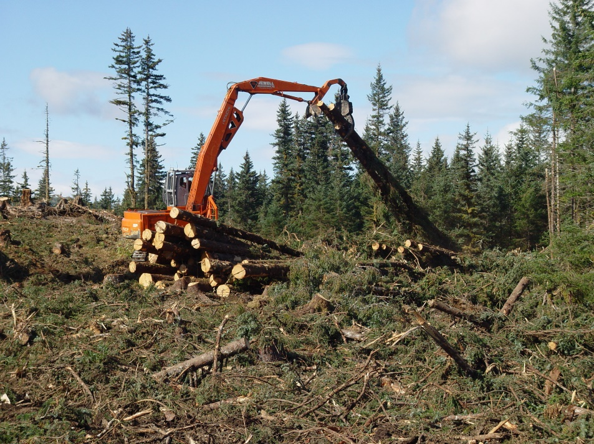
Tracked & wheeled harvest systems
A person may not skid timber or operate construction equipment or machinery on unstable slopes without prior notice to DOF.
11 AAC 95.365(a)(3)
Ground-based operations on Afognak Island.
Photo: Wade Wahrenbrock

Slide 32
Cable yarding
When using cable yarding operations on unstable slopes, minimize disturbance to soils, understory vegetation, stumps, and root systems.
11 AAC 95.360(c)(6)

Slide 33
Harvest unit planning & design
On unstable slopes, consider one or more of the following:
partial cuts;
retention areas;
use of helicopter or skyline systems to achieve full suspension of logs;
other techniques to minimize disturbance to soils, understory vegetation, stumps, and root systems.
11 AAC 95.340(d)

Slide 34
Road maintenance
If necessary to prevent significant degra­dation of surface water quality or fish habitat, DOF may require an operator or forest landowner to rehabilitate unstable or erodible exposed soils by a suitable method to minimize siltation of surface waters.
11 AAC 95.315(e)(4)

Slide 35
Road drainage
An operator shall to the extent feasible direct ditchline water away from unstable soils and surface waters, and onto vegetated areas.
11 AAC 95.295(f)

Slide 36
Road drainage, cont.
Direct sediment-laden discharges away from stream channels, intermittent stream channels, and unstable soils.
Provide a relief structure as close as practical to the stream crossing to relieve the ditchline before flows reach the crossing site.
Provide drainage relief where outflows can percolate into the soil, or direct drainage through sufficient vegetation to remove suspended sediment before reaching surface waters.
Low spots in the terrain or intervening ridges can be used to intercept discharges from the drainage relief structure, allowing suspended sediment to filter or settle out before reaching adjacent surface waters.
Purple book re 11 AAC 95.295(f)

Slide 37
Slope stability standards
Within designated riparian areas in Region I, slope stability standards also apply.
Avoid constructing a road that will under­cut the toe of a slope that has a high risk of slope failure.
Achieve full or partial suspension in yarding operations.
Fall timber away from streams in V-notches
Avoid side-casting of displaced soil from road construction to the maximum extent feasible.
11 AAC 95.280(d)(1),(3)-(5)

Slide 38
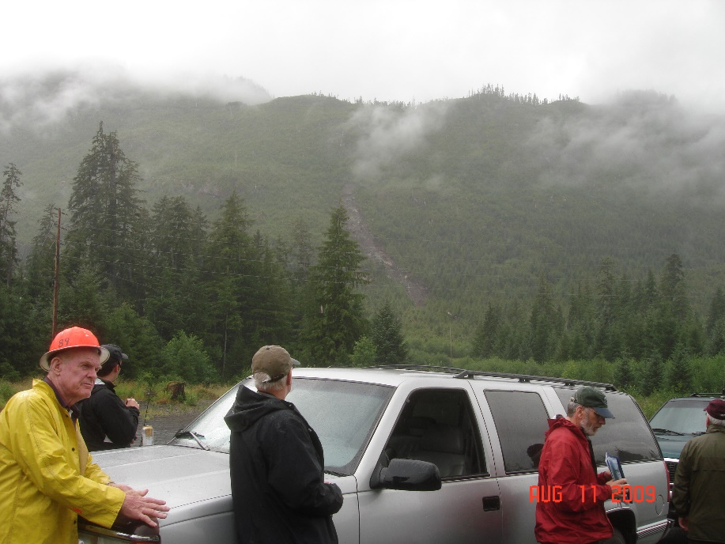
Slope stability standards
See also FRPA 101-F1 and F2 on Road construction, design, maintenance, and closure, and the purple book section on 11 AAC 95.280(d)(5) for considerations on side-casting
Board of Forestry viewing landslide above Port St. Nicholas road, Prince of Wales Island.
Photo: Jeff Foley

Slide 39
Reference-risk assessment
The procedures in Chatwin, et al., 1994 are recommended for additional guidance on assessing landslide risk.
Chatwin, S. C., D.E. Howes, J.W. Schwab, and D.N. Swanston. 1994. A guide for management of landslide-prone terrain in the Pacific Northwest. 2nd ed. British Columbia Ministry of Forests and U.S. Forest Service. 218 pp. This publication is available on-line through the British Columbia Ministry of Forests, Lands and Natural Resource Operations at:
http://www.for.gov.bc.ca/hfd/pubs/docs/lmh/Lmh18.htm
Purple book

Slide 40
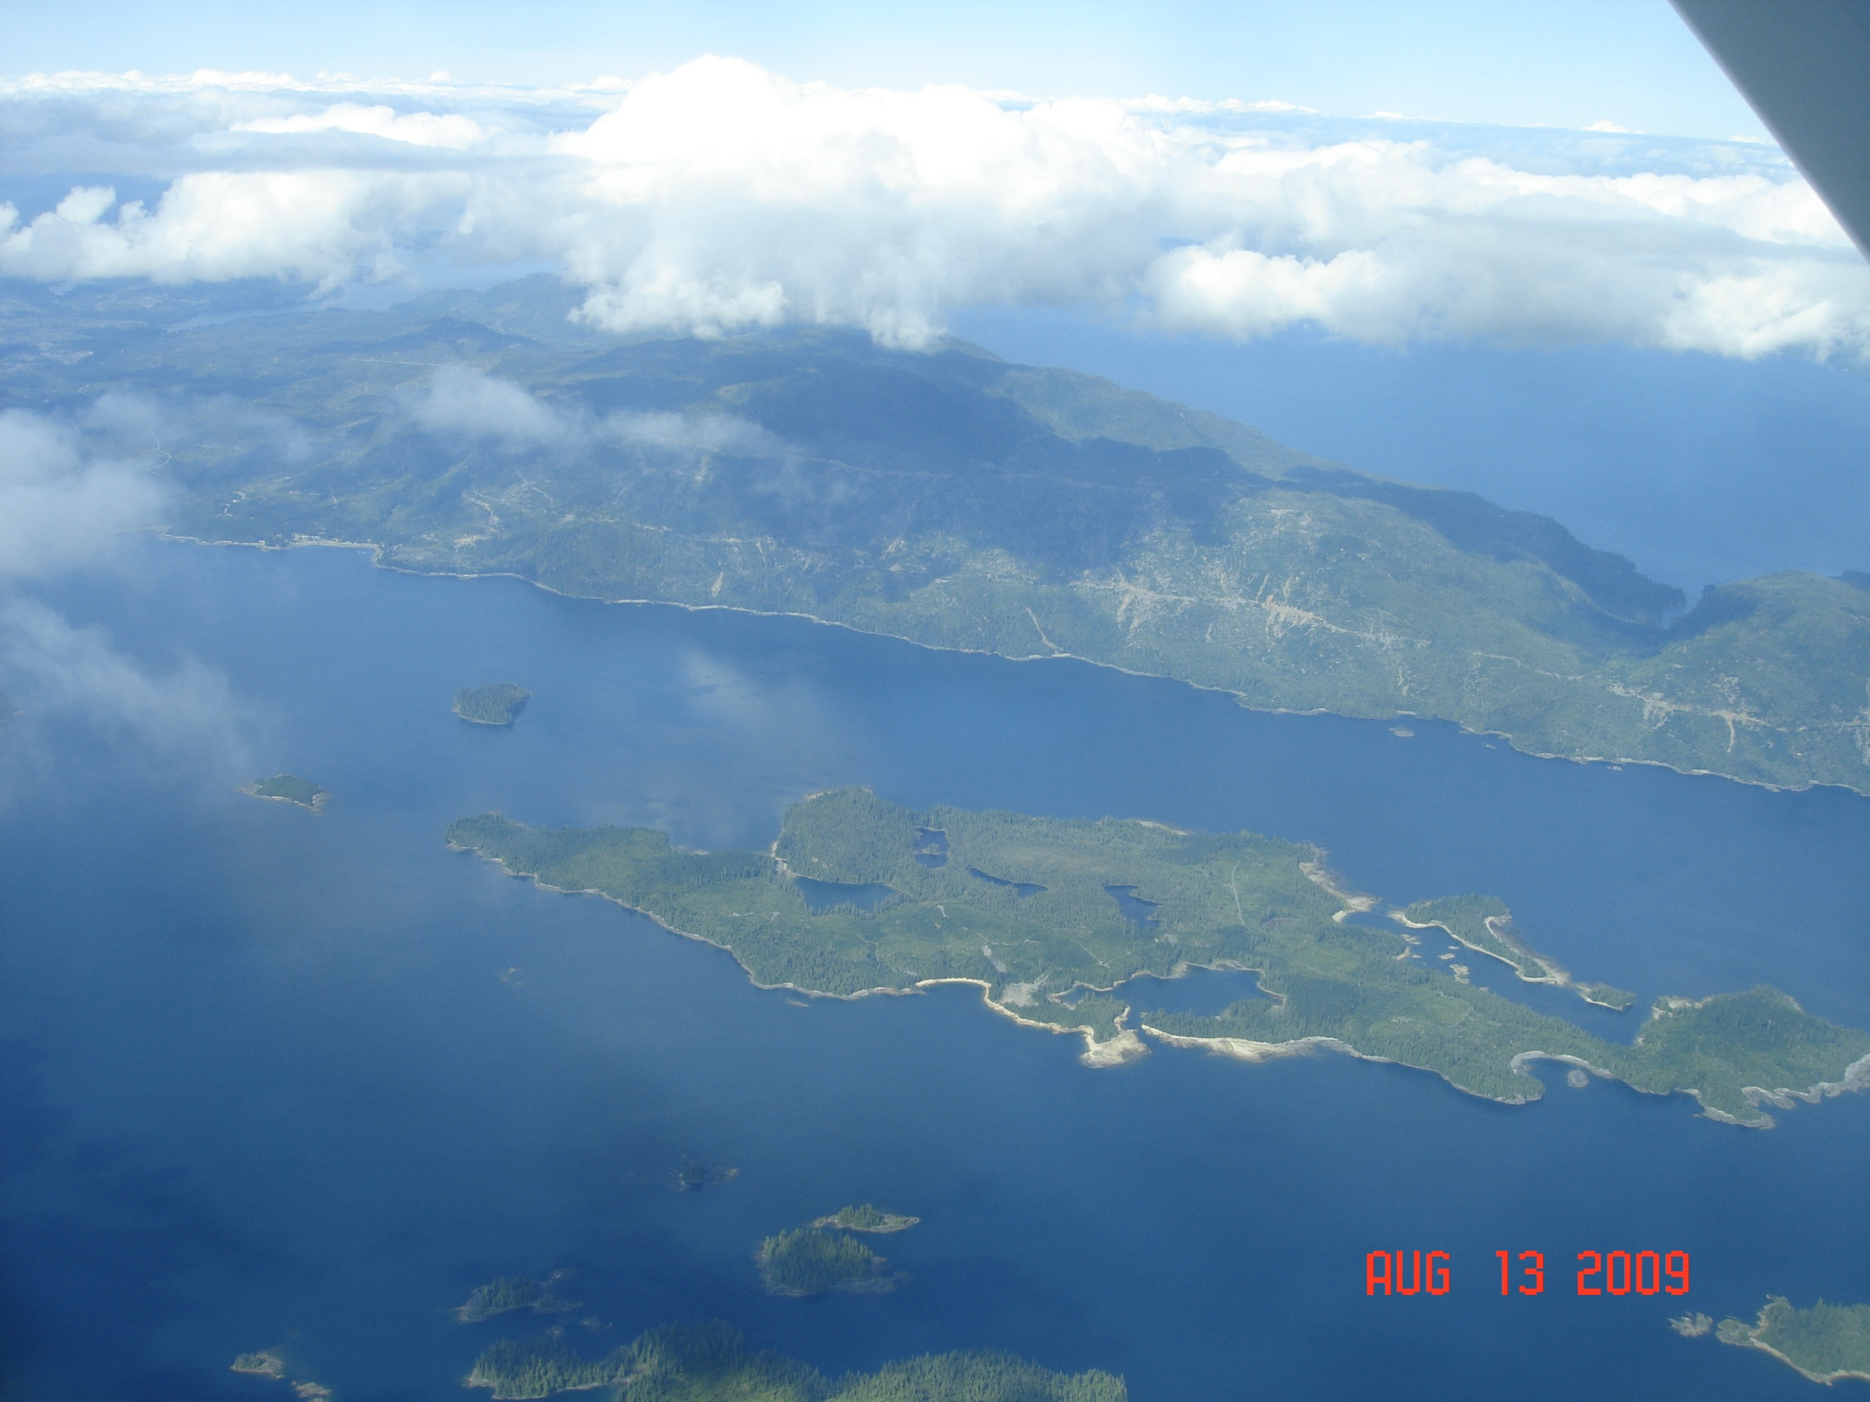
Questions?
Notes:
Kasaan – Jeff Foley

Slide 41
Addendum: Background Info

Slide 42
Area office contacts
Southeast Area Kenai-Kodiak Area
2417 Tongass Ave., Suite 213 HC 1, Box 107
Ketchikan, AK 99901 Soldotna, AK 99669
907-225-3070 907-262-4124
greg.staunton@alaska.gov hans.rinke@alaska.gov
Mat-Su/Southwest Area Fairbanks-Delta Area
101 Airport Road 3700 Airport Way
Palmer, AK 99645 Fairbanks, AK 99709-4699
907-761-6300 907-453-2600
edward.soto@alaska.gov paul.keech@alaska.gov
Tok-Copper River Area
P.O. Box 10
Tok, AK 99780
907-883-1400
derek.nellis@alaska.gov

Slide 43
Landslide review process
Information on the process used to update the FRPA landslide standards is available on the DOF website at:
http://forestry.alaska.gov/forestpractices#landslides
Available material includes:
Documentation of the review process, including the Science & Technical Review, Implementation Group, and Board of Forestry discussion and action
Scoping maps and caveats
Landslide model description
Bibliography of landslide research compiled by the S&TC

Slide 44
Caveat 1: Scoping
The scoping model and associated maps are tools for assessing the general scope of landslide hazards and public safety risks associated with commercial timber harvesting subject to the Alaska Forest Resources & Practices Act (FRPA). They do not replace the need for site-specific analysis and design of timber sales and access roads.

Slide 45
Caveat 2: Time scale
The location of public safety hazards will change over time as patterns of public use, public road access, land ownership, timber harvesting and other land uses change.

Slide 46
Caveat 3: Applicability
The scoping model is a first approximation based on available data of the geographic extent of potential landslide hazards in areas open to commercial timber harvest operations subject to FRPA where there is public use, in the portion of coastal Alaska from Cordova south.

Slide 47
Landslide Science & Tech Committee
Jim Baichtal USFS-Tongass National Forest Geologist
Marty Freeman DOF, chair
Kevin Hanley DEC Water Div. Environmental Prog. Spec.
Adelaide Johnson USFS-PNW Forest Sci. Lab, Hydrologist
Dennis Landwehr USFS Tongass Natl. Forest Soil Scientist
Kyle Moselle ADF&G Habitat Div. Douglas Hab. Biologist
Pat Palkovic DOF SSE Forest Practices Forester
Greg Staunton DOF Coastal Region Resource Mgr.
Ralph Swedell DOT&PF SE Region, Regl. Engineering Geol.
Technical support: Hans Buchholdt, DOF GIS Specialist

